Slide 1
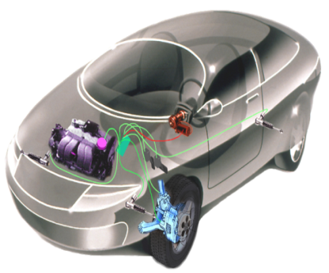
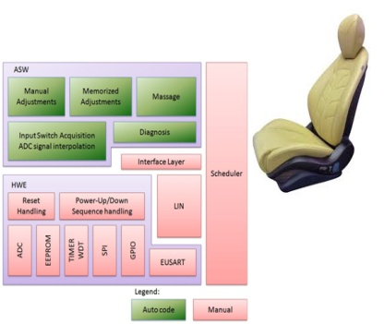
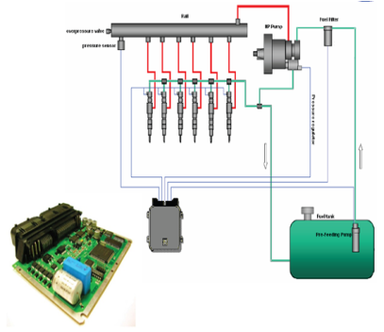
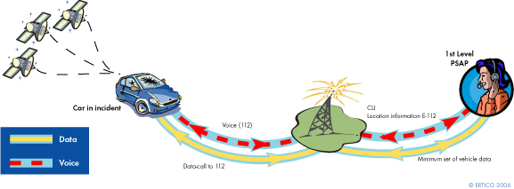
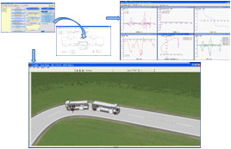
Live Webinar
Introduction to ISO 26262 for Functional Safety Critical Projects
Speaker-: Mr. Martin Heininger
Leading technology company award by Deloitte in Fast50 India 2012 program
Embitel is rated as one of the top 21 innovators in India by NASSCOM
Juror’s Distinction Award for Innovation in Manthan 2008
Nominated for Best UK Entrant in 2009 by UKTI
An ISO 9001:2008 certified company
Confidential

Slide 2

About the Speaker
  15 years of industry experience and has worked as a Lead
  and Project Consultant for Functional Safety projects.
  Functional Safety Seminars (IEC 61508, ISO26262,
  RTCA DO 178B)
  Functional Safety Consulting
  Functional Safety on Verification activities
  Consulting on Strategic Technical Project Management
Confidential

Slide 3
Contents
ISO 26262 Overview
ISO 26262 First Steps
ASIL Determination
ISO 26262 Life Cycle Work Products
Methods for Software Unit Implementation
Embitel-Heicon Collaboration
Confidential

Slide 4
ISO 26262 Overview
ISO 26262 is the adaption of IEC 61508 to comply with needs specific to road vehicles
Safety-related systems that include electrical and/or electronic (E/E) systems
Series production passenger cars (up to 3500kg max. vehicle mass)
ISO 26262 addresses possible hazards caused by malfunctions behavior of E/E safety-related systems and their interactions
ISO 26262 does not apply to hazards related to electrical shock, fire, smoke, heat, radiation, toxicity, flammability, reactivity, corrosion etc.
Confidential

Slide 5
ISO 26262 Overview
Confidential

Slide 6
ISO 26262 First steps
Hazard analysis and
risk assessment
Concept Phase
Derive ASIL Level
Specification of Safety Goals
Specification and management of safety requirements
Specification of System safety requirements
Product development
Hardware safety
requirements
Software safety
requirements
Architecture
Confidential

Slide 7
ASIL Determination
Exposure
E0 to E4
Controllability
C0 to C3
Severity
S0 to S3
ASIL
A to D
Class E0 E1 E2 E3 E4
Incredible | Very low probability | Low probability | Medium probability | High probability
(Probability of exposure regarding operational situations)
Class C0 C1 C2 C3
Controllable in general | Simply controllable | Normally controllable | Difficult to control or uncontrollable
Class S0 S1 S2 S3
No injuries | Light and moderate injuries | Severe and life-threatining injuries (survival probable) | Life-threatening injuries (survival uncertain), fatal injuries
Confidential

Slide 8
ASIL Determination
Severity class | Probability class | Controllability class C1 C2 C3
S1 | E1 | QM | QM | QM
 | E2 | QM | QM | QM
 | E3 | QM | QM | A
 | E4 | QM | A | B
S2 | E1 | QM | QM | QM
 | E2 | QM | QM | A
 | E3 | QM | QM | B
 | E4 | A | B | C
S3 | E1 | QM | QM | A
 | E2 | QM | A | B
 | E3 | A | B | C
 | E4 | B | C | D
  ISO 26262-3
Note: The class QM (Quality Management) denotes no requirement to comply with ISO 26262
Confidential

Slide 9
Content
ISO 26262 Overview
ISO 26262 First Steps
ASIL Determination
ISO 26262 Life Cycle Work Products
Methods for Software Unit Implementation
Embitel-Heicon Collaboration
Confidential

Slide 10
ISO 26262 Work Products – Functional Safety Mngt.
Work Products
Organizational-specific rules and processes for functional safety Evidence of competence Evidence of quality management Functional safety assessment plan Evidence of field monitoring
Hazard analysis and
risk assessment
Functional Safety Management
  ISO/FDIS 26262-2
Confidential

Slide 11
ISO 26262 Work Products – Concept Phase
Work Products
Impact Analysis (Development of new Product or Modification of existing Product) Hazard analysis and risk assessment Safety goals Functional safety concept (Requirements) Verification (Review) report
Hazard analysis and
risk assessment
Concept Phase
  ISO 26262-3
Confidential

Slide 12
ISO 26262 Work Products – Production
Work Products
Safety-related content of the production plan Safety-related content of the production control plan Control measure report Assessment report for capability of the production process Safety-related content of the maintenance plan Repair instructions Safety-related content of the information made available to the user Instructions regarding field observations Safety related content of the instructions for decommissioning
Hazard analysis and
risk assessment
Production, Maintenance
  ISO 26262-7
Confidential

Slide 13
ISO 26262 Work Products – Supporting Fkt.
Work Products – Distributed Development
Supplier selection report Development interface agreement Supplier’s project plan Safety assessment report Supply agreement
Work Products – Config Managmt
Configuration Management Plan
Hazard analysis and
risk assessment
Work Products – Change Management
Change management plan Change request Impact analysis and change request plan Change report
Work Products - Documentation Process
Document management plan Documentation guideline requirements
Product Development
  ISO 26262-8
Work Products – Tool Qualification
Software tool criteria evaluation report Software tool qualification report
Confidential

Slide 14
ISO 26262 Work Products – ASIL and
safety oriented analysis
Hazard analysis and
risk assessment
Work Products
Update of the corresponding Documentation due to Requirements decomposition with respect to ASIL tailoring Analysis of dependent failures Safety analysis
ASIL and safety-oriented analysis
  ISO 26262-9
Confidential

Slide 15
Embedded System/Software Life Cycle
Details see Slide 16
Details see Slide 17
Confidential

Slide 16
ISO 26262 Work Products – System Level
  ISO 26262-4
Confidential

Slide 17
ISO 26262 Work Products – Software Level
  ISO 26262-6
Confidential

Slide 18
Embedded System/Hardware Life Cycle
Details see Slide 19
Confidential

Slide 19
ISO 26262 Work Products – Hardware Level
  ISO 26262-5
Confidential

Slide 20
Content
ISO 26262 Overview
ISO 26262 First Steps
ASIL Determination
ISO 26262 Life Cycle Work Products
Software Unit Implementation Methods
Embitel-Heicon Collaboration
Confidential

Slide 21
Software Unit Implementation Methods
Methods | ASIL A | ASIL B | ASIL C | ASIL D
One entry and one exit point in subprograms and functions | ++ | ++ | ++ | ++
No dynamic objects or variables, or else online test during their creation | + | ++ | ++ | ++
Initialization of variables | ++ | ++ | ++ | ++
No multiple use of variable names | + | ++ | ++ | ++
Avoid global variables or else justify their usage | + | + | ++ | ++
Limited use of pointers | o | + | + | ++
No implicit type conversions | + | ++ | ++ | ++
No hidden data flow or control flow | + | ++ | ++ | ++
No unconditional jumps | ++ | ++ | ++ | ++
No recursions | + | + | ++ | ++
  ISO 26262-6
Confidential

Slide 22
HEICON
Our Collaboration & Services
ISO 26262 Consultancy
Functional Safety Validation & Verification
ISO 26262 Tool Qualifications
Automotive Software & Hardware development
22
Confidential

Slide 23
Q & A

Slide 24







International Presence
embitel – A Partner For You
Please Send Additional queries to:
e.seminar@embitel.com

